Slide 1

Capacity of Florida’s Infrastructure for Resource Recovery & Solid Waste Management
Researchers: Hannah Sackles, Malak Anshassi, Yalan Liu, Steve Laux, Tim Townsend
FDEP: Karen Moore, Chris Perry

Slide 2
Florida SWIFR Activities
Capacity Study
  Preliminary results included in this presentation
Away from Home Waste and Recycling Study
Update WasteCalc Activity
https://www.epa.gov/infrastructure/recycling-grant-selectees-and-recipients

Slide 3
Facilities of Interest
Disposal
Landfills
Ash Monofill
Class I
Class III
CDD
Waste-to-Energy
Processing
Recycling
Class I
Organics Processing
Food Waste & Manure
Yard Trash
Class III/CDD
Used Oil Processing
Anaerobic Digestion
HHW

Slide 4
Facilities of Interest
Disposal
Landfills
Ash Monofill
Class I
Class III
CDD
Waste-to-Energy
Processing
Recycling
Class I
Organics Processing
Food Waste & Manure
Yard Trash
Class III/CDD
Used Oil Processing
Anaerobic Digestion
HHW

Slide 5
Facilities of Interest
Disposal
Landfills
Ash Monofill
Class I
Class III
CDD
Waste-to-Energy
How long will Florida’s current landfill capacity last?

Slide 6
Method to Determine Class I Landfill Capacity
F.A.C. 62-701.500.13: Recordkeeping. In addition to records and reporting required by other sections of this chapter, the landfill owner or operator shall: (c) Maintain an annual estimate of the remaining life and capacity in cubic yards of the existing, constructed landfill and an annual estimate of the life and capacity in cubic yards of other permitted areas not yet constructed. The estimate shall be made and reported annually to the Department.
https://www.flrules.org/gateway/ruleno.asp?id=62-701.500

Slide 7
Method to Determine Class I Landfill Capacity
Use OCULUS to search for:
  Site life estimate
  Annual tonnages
  Permit applications
Verify information with facility operators
  Tonnages, density, and site life estimate
  Potential for future expansions
Normalize each facility’s capacity estimate to a single date
  January 1st, 2025

Slide 8
Statewide Class I Landfill Capacity
458.1 M permitted tons remaining as of Jan. 1, 2025

Slide 9
Statewide Class I Landfill Capacity
20.9 M tons to
Class I Landfills in 2023
458.1 M permitted tons remaining as of Jan. 1, 2025
123.1 M constructed tons remaining as of Jan. 1, 2025

Slide 10
Statewide Class I Landfill Capacity
0%
2046
458.1 M permitted tons remaining as of Jan. 1, 2025
2030
123.1 M constructed tons remaining as of Jan. 1, 2025

Slide 11
Statewide Class I Landfill Capacity
1%
0%
2046
458.1 M permitted tons remaining as of Jan. 1, 2025
2044
123.1 M constructed tons remaining as of Jan. 1, 2025
2030

Slide 12
Statewide Class I Landfill Capacity
3%
1%
0%
2046
458.1 M permitted tons remaining as of Jan. 1, 2025
2041
2044
2029
123.1 M constructed tons remaining as of Jan. 1, 2025
2030

Slide 13
Statewide Class I Landfill Capacity
5%
3%
1%
0%
2039
2046
458.1 M permitted tons remaining as of Jan. 1, 2025
2041
2044
2029
123.1 M constructed tons remaining as of Jan. 1, 2025
2030

Slide 14
Statewide Class I Landfill Capacity
0%
-1%
2046
2049
458.1 M permitted tons remaining as of Jan. 1, 2025
123.1 M constructed tons remaining as of Jan. 1, 2025
2030

Slide 15
Statewide Class I Landfill Capacity
0%
-1%
-3%
2046
2059
458.1 M permitted tons remaining as of Jan. 1, 2025
2049
123.1 M constructed tons remaining as of Jan. 1, 2025
2030

Slide 16
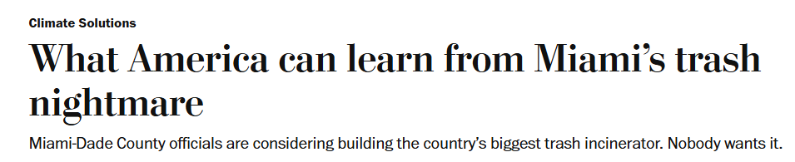
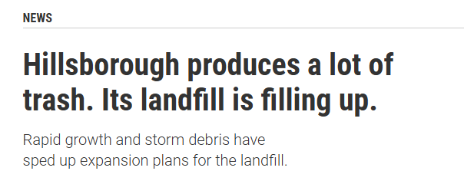
Washington Post,
January 28, 2025
Tampa Bay Times,
February 4, 2025
How does landfill capacity vary by region?

Slide 17
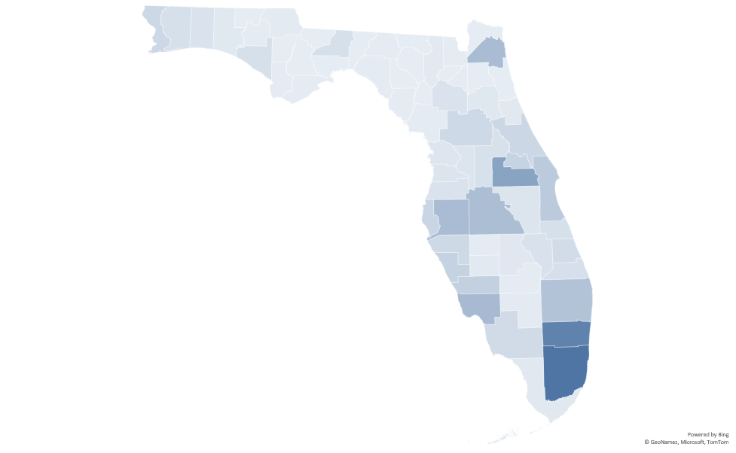
Origin of Waste Disposed of in Class I Landfills in 2023
2.6 M tons
2023 Tons Landfilled
0 tons

Slide 18
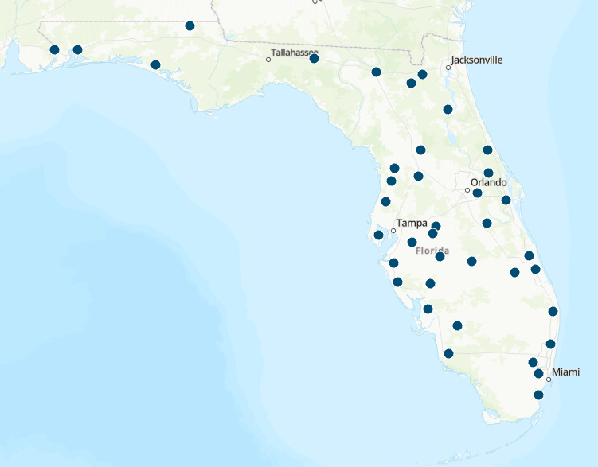

Origin of Waste and Location of Class I Landfills
2.6 M tons
2023 Tons Landfilled
0 tons
Class I Landfill

Slide 19
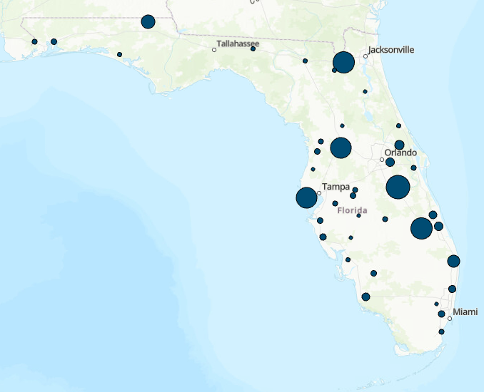
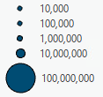
Origin of Waste and Capacity of Class I Landfills
2.6 M tons
2023 Tons Landfilled
0 tons
Tons of Permitted Capacity Remaining as of Jan. 1, 2025

Slide 20
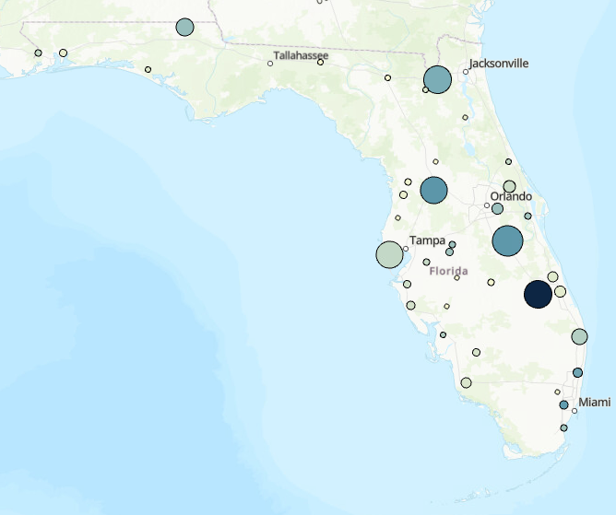
Origin of Waste and Capacity of Class I Landfills
0 tons
2.6 M tons
2023 Tons Accepted
2023 Tons Landfilled
2.5 M tons
0 tons
Tons of Permitted Capacity Remaining as of Jan. 1, 2025

Slide 21
Remaining Permitted Class I Capacity as of Jan. 1, 2025
Different colors correspond to a separate facility in each district
139.2 M tons
119.6 M tons
75.3 M tons
56.5 M tons
38.8 M tons
28.5 M tons

Slide 22
Method to Project Remaining Regional Capacity
Southeast District Example
Calendar Year | Waste Received (tons) | Percent Waste Disposal Increase | Remaining Permitted Tons at Beginning of Calendar Year
2023 | 6,870,375.13 | 2.76%
2024 | 7,059,997 | 2.76%
2025 | 7,254,853 | 2.76% | 119,648,343
2026 | 7,455,087 | 2.76% | 112,393,489
2027 | 7,660,848 | 2.76% | 104,938,402
2028 | 7,872,287 | 2.76% | 97,277,554
2029 | 8,089,562 | 2.76% | 89,405,267
2030 | 8,312,834 | 2.76% | 81,315,705
2031 | 8,542,268 | 2.76% | 73,002,870
2032 | 8,778,035 | 2.76% | 64,460,602
2033 | 9,020,309 | 2.76% | 55,682,567
2034 | 9,269,269 | 2.76% | 46,662,258
2035 | 9,525,101 | 2.76% | 37,392,989
2036 | 9,787,994 | 2.76% | 27,867,887
2037 | 10,058,143 | 2.76% | 18,079,893
2038 | 10,335,747 | 2.76% | 8,021,751
2039 | 10,621,014 | 2.76% | -2,313,996
2040 | 10,914,154 | 2.76% | -12,935,010
1) Determine tons landfilled in each facility in 2023
Obtained from Solid Waste Quantity Report and verified with operators
2) Apply annual percent increase in waste disposal
5-year average increase in disposal (2018-2023) for all facilities in district
3) Project the remaining capacity (in tons) after accounting for waste disposed in each calendar year

Slide 23
Remaining Permitted Class I Capacity as of Jan. 1, 2025

Slide 24
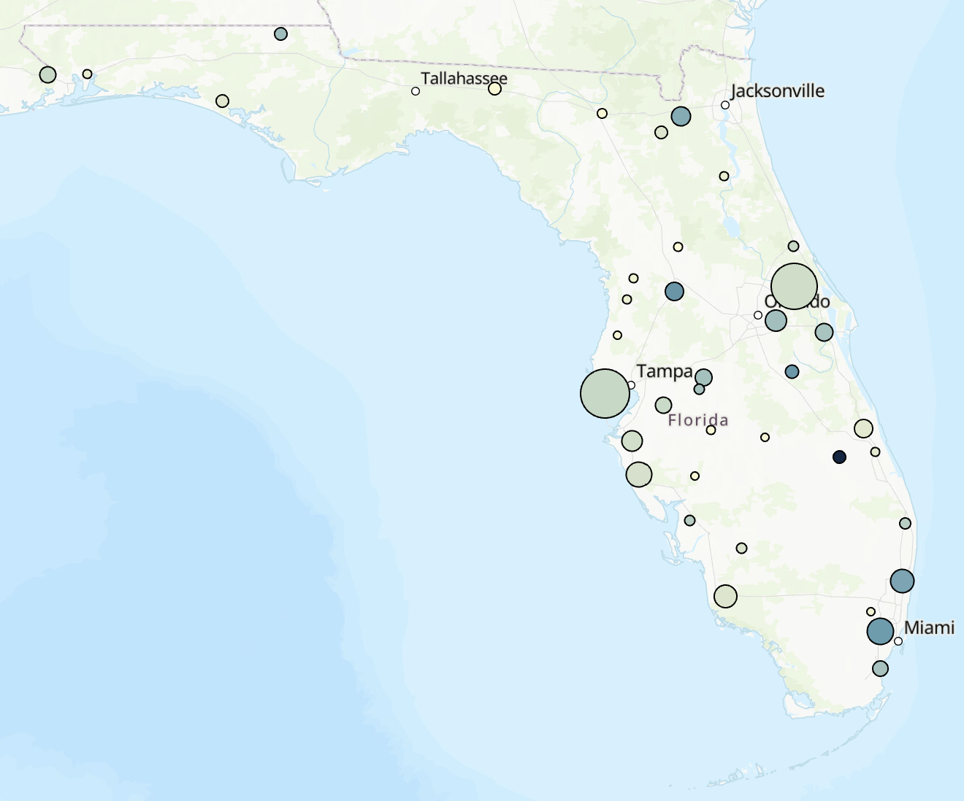

Permitted vs Constructed Capacity of Class I Landfills
0 tons
0 tons
2023 Tons Accepted
2023 Tons Accepted
2.5 M tons
2.5 M tons
Tons of Permitted Capacity Remaining as of Jan. 1, 2025
Tons of Constructed Capacity Remaining as of Jan. 1, 2025

Slide 25
Remaining Constructed Class I Capacity as of Jan. 1, 2025
Different colors correspond to a separate facility in each district
32.7 M tons
31.5 M tons
26 M tons
15.4 M tons
9.6 M tons
7.9 M tons

Slide 26
Remaining Class I Landfill Capacity as of Jan. 1, 2025
Different colors correspond to a separate facility in each district
Constructed Capacity
139.2M
tons
Permitted Capacity
119.6M
tons
75.3M
tons
56.5M
tons
38.8M
tons
32.7M
tons
28.5M
tons
31.5M
tons
26M
tons
15.4M
tons
9.6M
tons
7.9M
tons
24%
17%
20%
54%
22%
42%

Slide 27
Remaining Class I Landfill Capacity as of Jan. 1, 2025

Slide 28
Facilities of Interest
Disposal
Landfills
Ash Monofill
Class I
Class III
CDD
Waste-to-Energy
Processing
Recycling
Class I
Organics Processing
Food Waste & Manure
Yard Trash
Class III/CDD
Used Oil Processing
Anaerobic Digestion
HHW

Slide 29
Facilities of Interest
Disposal
Landfills
Ash Monofill
Class I
Class III
CDD
Waste-to-Energy
Processing
Recycling
Class I
Organics Processing
Food Waste & Manure
Yard Trash
Class III/CDD
Used Oil Processing
Anaerobic Digestion
HHW

Slide 30
Facilities of Interest
Disposal
Landfills
Ash Monofill
Class I
Class III
CDD
Waste-to-Energy
How much capacity do Florida’s WTE facilities have?

Slide 31
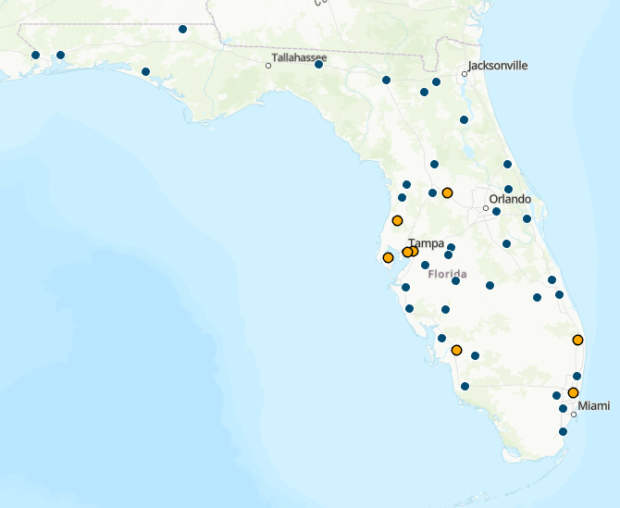
Location of Florida’s WTE Facilities
WTE Facility
Class I Landfill

Slide 32
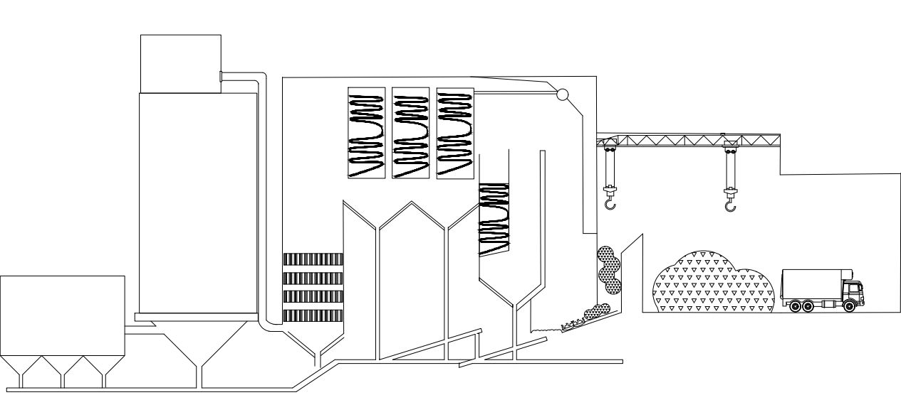
Method to Determine WTE Capacity
Air Emissions
type of material burned
amount of material burned
Number of Boilers
Waste Composition
capacity
heating value

Slide 33
Method to Determine WTE Capacity
Use publicly-available for:
  Processing capacity from ACFR, processing reports from OCULUS
  Permitting information through the Power Plant Siting Act
Verify information with facility operators
  Processing capacity, composition of waste managed, 2023 tons
  Potential for future expansions

Slide 34
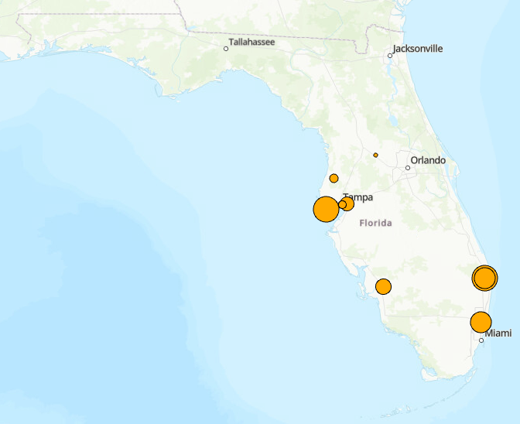
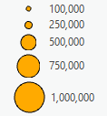
Florida’s WTE Capacity as of January 2025
2.64 M tons
2.19 M tons
0.61 M tons
0.16 M tons
Tons of Annual WTE Capacity

Slide 35
Facilities of Interest
Disposal
Landfills
Ash Monofill
Class I
Class III
CDD
Waste-to-Energy
Processing
Recycling
Class I
Organics Processing
Food Waste & Manure
Yard Trash
Class III/CDD
Used Oil Processing
Anaerobic Digestion
HHW

Slide 36
Facilities of Interest
Disposal
Landfills
Ash Monofill
Class I
Class III
CDD
Waste-to-Energy
Processing
Recycling
Class I
Organics Processing
Food Waste & Manure
Yard Trash
Class III/CDD
Used Oil Processing
Anaerobic Digestion
HHW

Slide 37
Facilities of Interest
Processing
Recycling
Class I
Organics Processing
Food Waste & Manure
Yard Trash
Class III/CDD
Used Oil Processing
Anaerobic Digestion
HHW
How much capacity do Florida’s single and dual stream MRFs have?

Slide 38
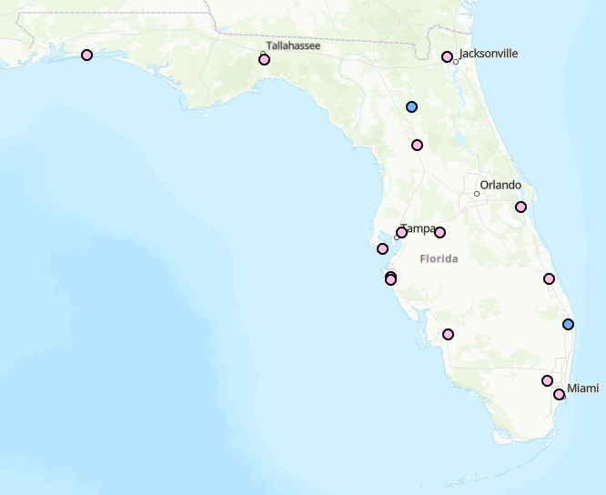
Location of Florida’s Single and Dual Stream MRFs
Single Stream MRF
Dual Stream MRF

Slide 39
Method to Determine MRF Capacity
Limited publicly-available MRF data
  Recycling totals available in annual solid waste reports
Rely on conversations with facility operators
  Processing capacity, contamination rate, service area
  Potential for future expansions
  Challenges and opportunities

Slide 40
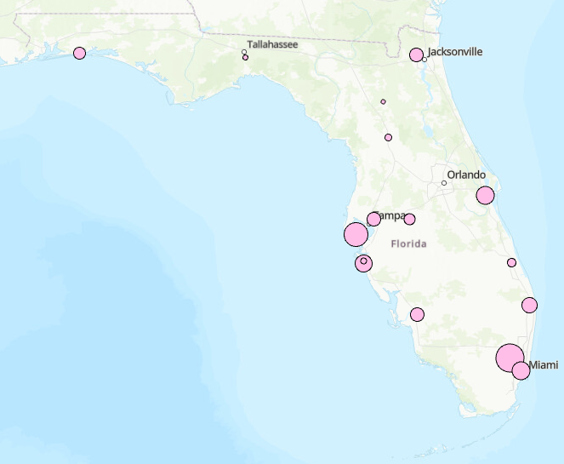

Florida’s MRF Capacity as of January 2025
498,500 tons
338,000 tons
246,000 tons
161,000 tons
109,000 tons
97,250 tons
Tons of Annual MRF Capacity

Slide 41
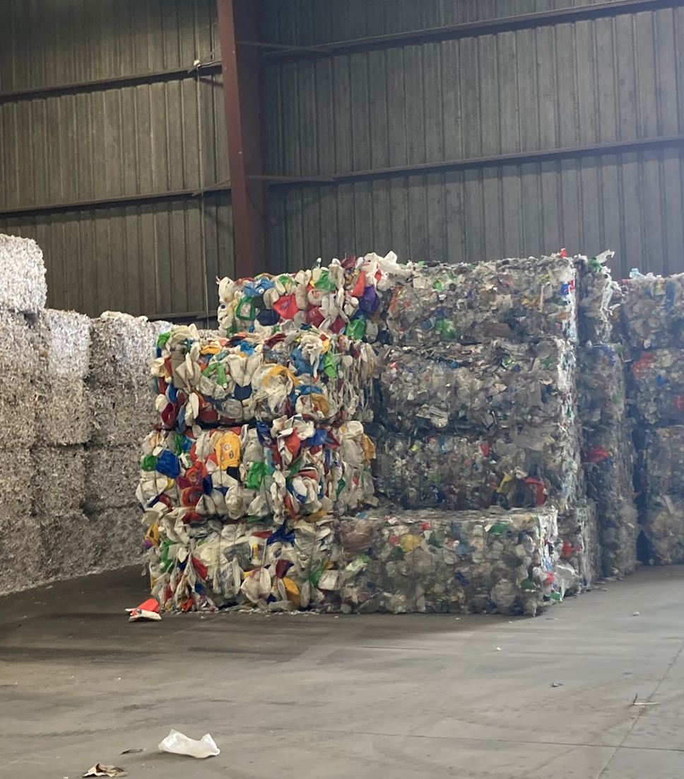
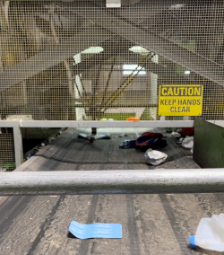
There is capacity to manage the materials currently recycled in the state.
Infrastructure in Central and South Florida is generally operating at capacity.
The industry is moving toward increased automation.

Slide 42
Key Takeaways…
Class I Landfills:
Currently, about a third of the state’s remaining permitted capacity has already been constructed.
Capacity varies by region and public vs private landfills.
WTE Facilities:
Florida’s WTE facilities are operating at capacity and have little room for expansion.
Single and Dual Stream MRFs:
MRFs can process all material currently being generated in the state.
However, MRFs in Central and South Florida are operating at capacity.

Slide 43
Thank you and please connect with us!
Hannah Sackles
Graduate Research Assistant
University of Florida
hsackles@ufl.edu
Dr. Malak Anshassi
Assistant Professor
Florida Polytechnic University
manshassi@floridapoly.edu
Dr. Yalan Liu
Assistant Professor
Florida Atlantic University
yalanliu@fau.edu

